Slide 1
EEG-Based Classification of Alzheimer's Disease & FTD
Using Hand-Crafted Features and Deep Learning
Ammar Omar · Oğuzhan Memiş
Yildiz Technical University | BME5013 Biomedical Signal Processing | June 2026

Slide 2
Motivation
• 55M+ people live with dementia worldwide
• Alzheimer's Disease (AD): 60–70% of all dementia cases
• Frontotemporal Dementia (FTD): #2 young-onset subtype
• AD vs FTD: overlapping early symptoms → misdiagnosis common
Why EEG?
• Non-invasive & low cost
• High temporal resolution (ms-level)
• Captures cortical oscillation changes
• AD: ↑ δ/θ power, ↓ α/β
• FTD: frontal θ elevation, preserved α
36
23
29
AD subjects
FTD subjects
HC subjects
Goal: Automatic 3-class separation AD / FTD / HC from resting-state EEG

Slide 3
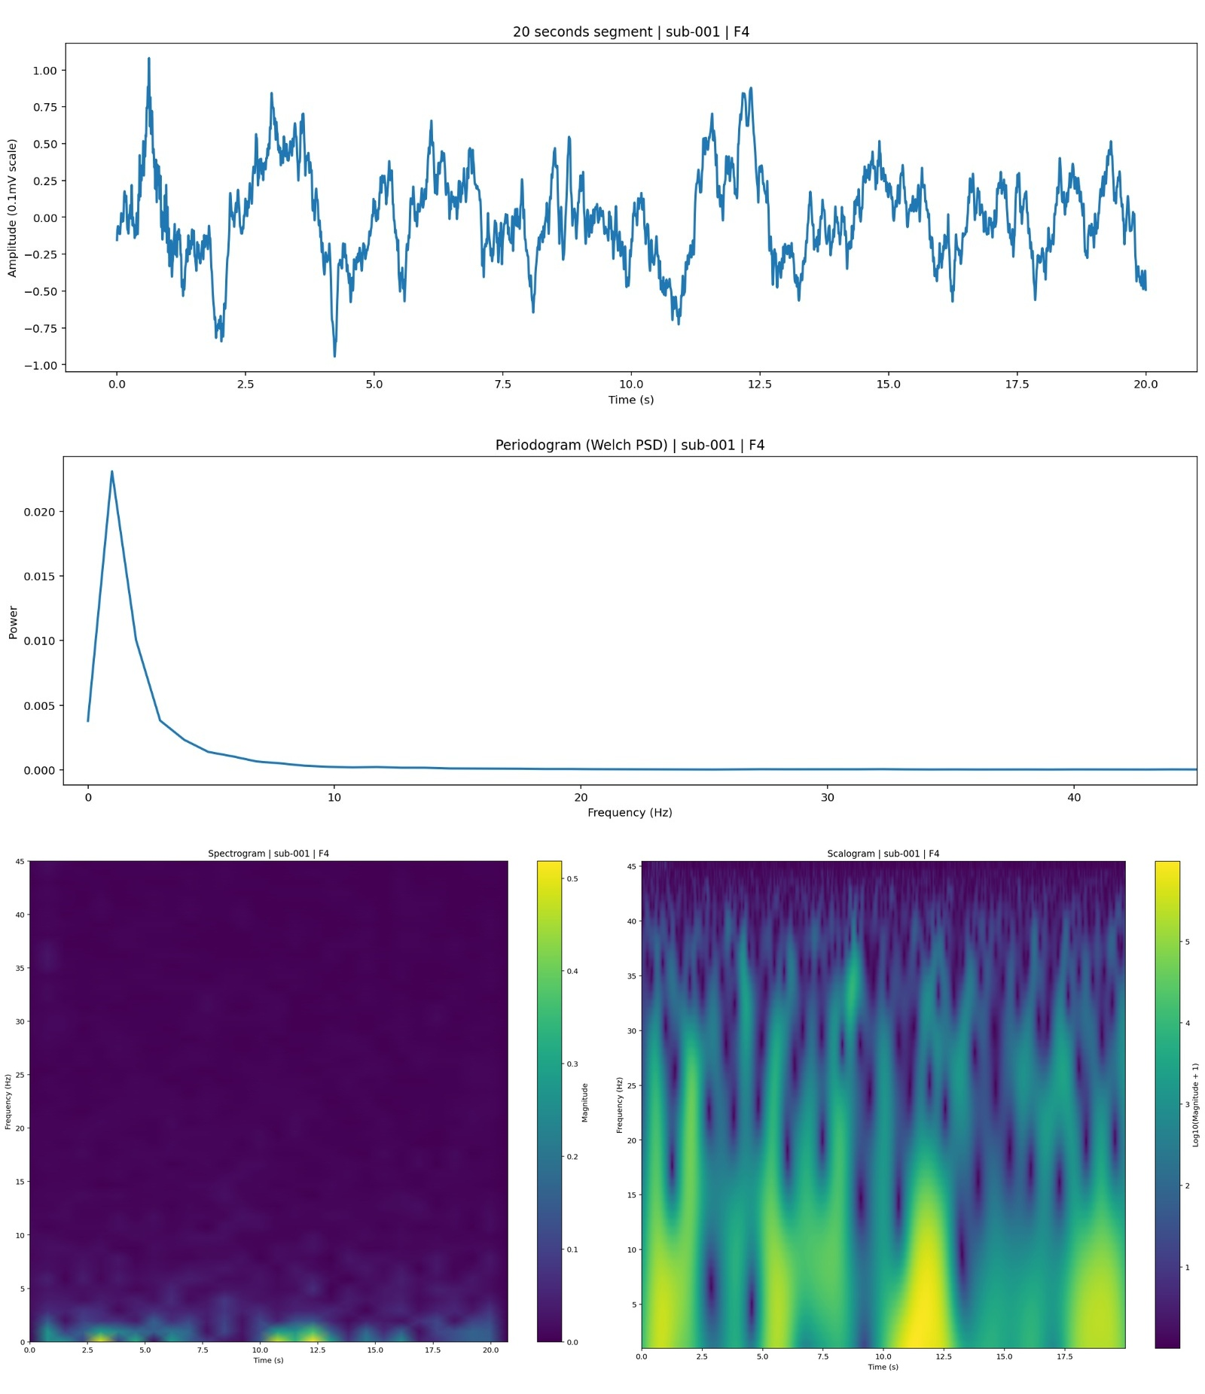
Dataset — OpenNeuro ds004504
• 88 subjects: 36 AD · 23 FTD · 29 HC
• 19 channels, 500 Hz, eyes-closed resting state
• Pre-processing: BPF 0.5–45 Hz → ASR → ICA
• Duration: ~3 to 10+ min per subject
• Signal scaled to 0.1 mV range (≈ ±150 µV)
Fig 1. EDA — sub-001 (AD), channel F4: time series · Welch PSD · CWT scalogram · STFT spectrogram

Slide 4
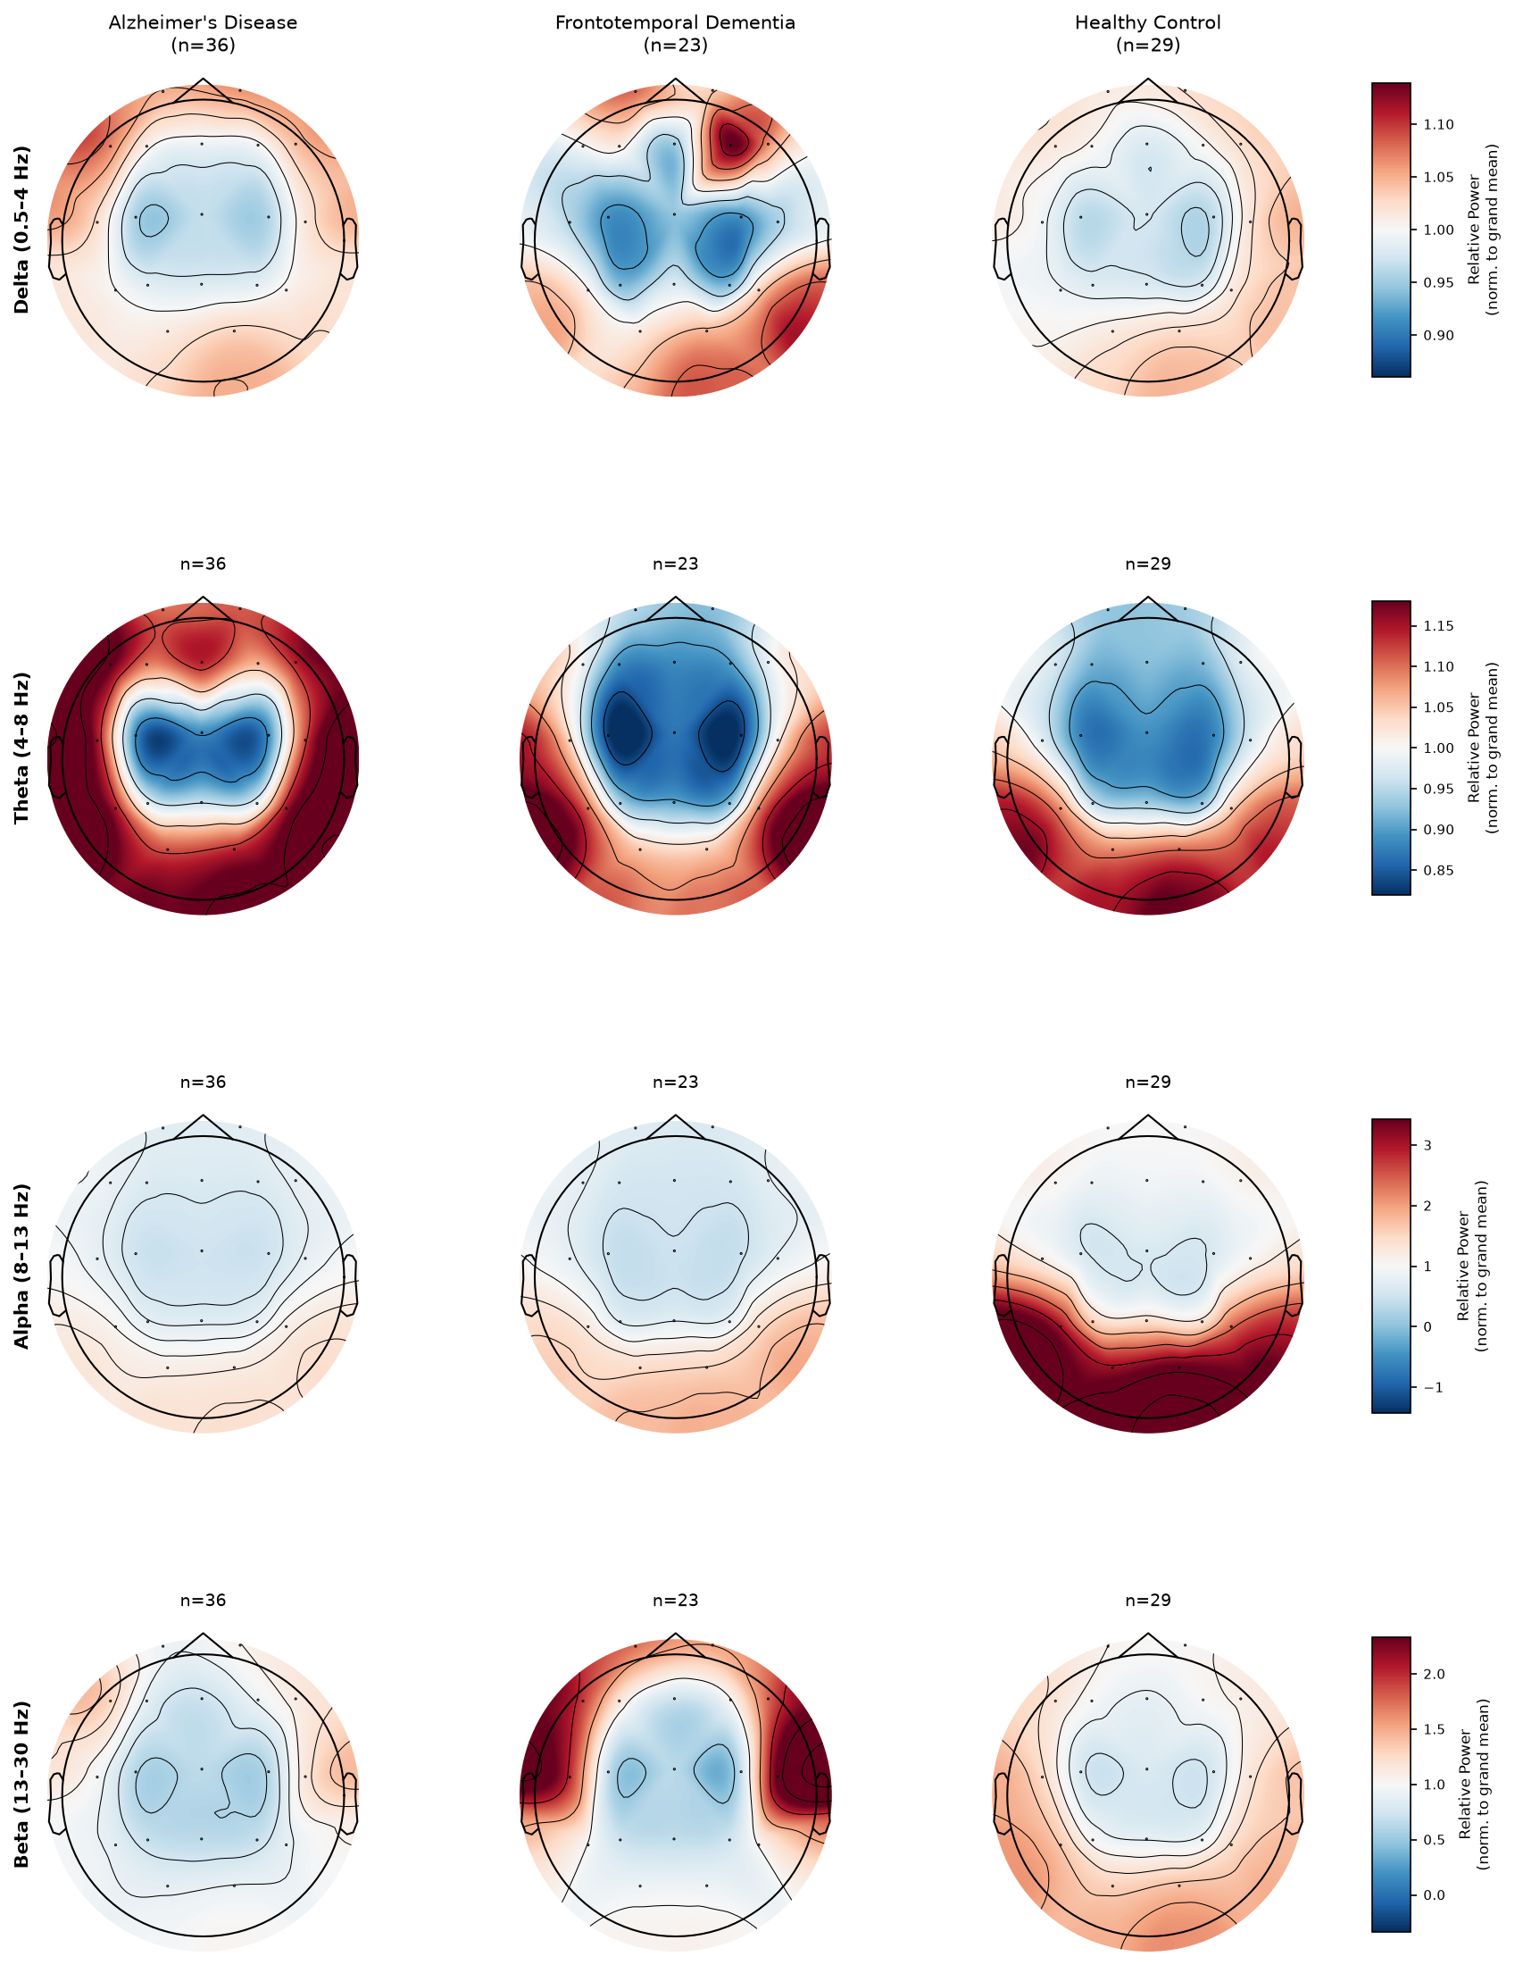
Band-Power Topography Maps
Key Findings
AD: ↑ δ/θ posterior, ↓↓ α
FTD: ↑ frontal θ, α preserved
HC: dominant occipital α
Grand-mean normalised Welch PSD across all 88 subjects

Slide 5
Data Split & Leakage Prevention
TRAIN
VALIDATION
TEST
70%
10%
20%
~62 subjects
~9 subjects
~17 subjects
• All segments of one subject → same partition only (no leakage)
• Runtime assertion: Train ∩ Val ∩ Test = ∅ (halts if violated)
• Class weights: w_c = N_total / (3 × N_c) to handle imbalance
• Segment shuffle with random_state = 42 for reproducibility
Most literature uses LOSOCV — our held-out split is stricter and more conservative

Slide 6
Pipeline 1 — Hand-Crafted Features
Feature Group | Count | Examples
Time-domain | 27 | Hjorth, entropy, ZCR, kurtosis
Frequency-domain | 20 | Band powers δ/θ/α/β, centroid
DWT (db4, 5-level) | 12 | Sub-band energy, wavelet entropy
× 19 channels | = 1,121
Inter-ch. coherence | 684 | 171 pairs × 4 bands
TOTAL / epoch | 1,805
1,805 features
StandardScaler + PCA 95%
SVM · RF XGBoost
Majority Vote (subject)
Prediction AD/FTD/HC
→
→
→
→
Best: XGBoost — 72.2% subject accuracy

Slide 7
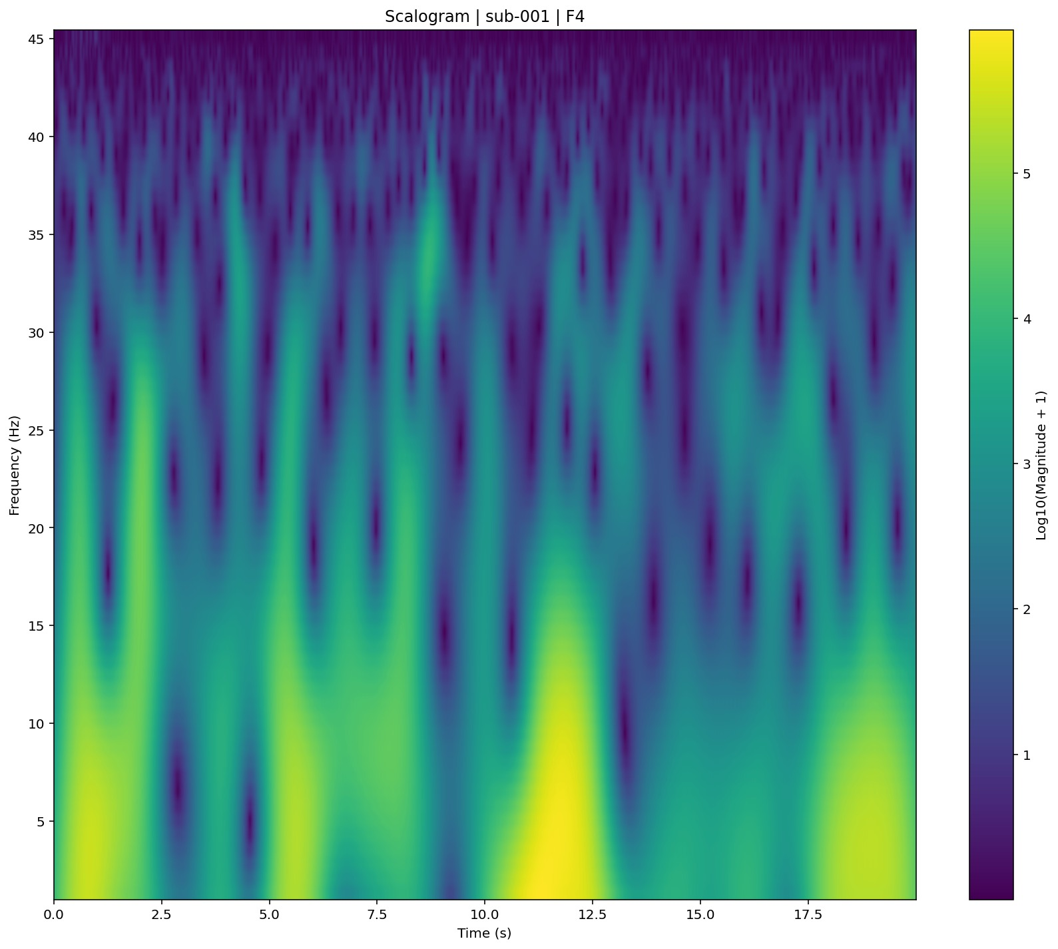
Pipeline 2 — CWT Scalogram + Deep Learning
CWT scalogram (19, 60, 1000) tensor
7 Architectures tested:
• Custom CNN (AlexNet-style)
• EfficientNet-B0
• ResNet-50 variant
• DenseNet
• ViT (DeiT-Tiny)
• YOLO26s-cls
• YOLO26m-cls ← best single
• Wavelet: cmor-1.0-1.0
• 60 scales (11 → 500)
• Log compression: 10·log₁₀(|W|+1)
• 10× time decimation → 1,000 pts
★ One-vs-Rest (OvR) Ensemble
• 3 binary YOLO26m-cls models: model_AD · model_FTD · model_HC
• Decision = argmax [ P_AD(1), P_FTD(1), P_HC(1) ]
• Threshold optimisation on val set (19³ = 6,859 combos) → 88.89%

Slide 8
Literature Benchmark — ds004504
Study | Method | Task | Best Result
DICE-Net [2023] | STFT + Conv-Transformer | 3-class | ~83% Acc
Rostamikia [2024] | Lyapunov + SVM | 3-class | 90.2% Acc
Si et al. [2023] | PLV graph + SVM | Binary | 89.6% Acc
Ajra et al. [2023] | AEC + Shallow CNN | Binary | 94.54% Acc
Zheng et al. [2025] | Time-freq FC + SVM | Binary | 95.4% Acc
Stefanou et al.[2025] | STFT CNN | Binary | 97.3% Acc
Mlinaric et al.[2026] | Riemannian stacking | Binary | AUC 0.82
★ This work | CWT OvR YOLO26m+Thresh | 3-class | 88.89% Subj.Acc
Most >90% results use LOSOCV or binary tasks — not directly comparable to our 3-class held-out split

Slide 9
Results — All 15 Models (Test Set)
Classical ML
Deep Learning
Model | Subj. Acc. | Subj. F1 | AUC
SVM (RBF, C=10) | 66.7% | 52.3% | 85.3%
Random Forest (300) | 66.7% | 51.6% | 76.1%
XGBoost (300, depth 6) | 72.2% | 64.8% | 73.6%
Model | Subj. Acc. | Subj. F1
Custom CNN | 72.22% | 67.04%
EfficientNet-B0 | 55.56% | 55.31%
ResNet-50 variant | 61.11% | 59.03%
DenseNet | 50.00% | 50.00%
ViT (DeiT-Tiny) | 61.11% | 58.06%
YOLO26s-cls | 66.67% | 62.38%
YOLO26m-cls | 77.78% | 77.08%
OvR Baseline | 83.33% | 82.64%
★ OvR + Threshold | 88.89% | 88.77%
EEGNet: 22.2% | ShallowConvNet: 66.7% | SpectrogramCNN: 50.0%

Slide 10
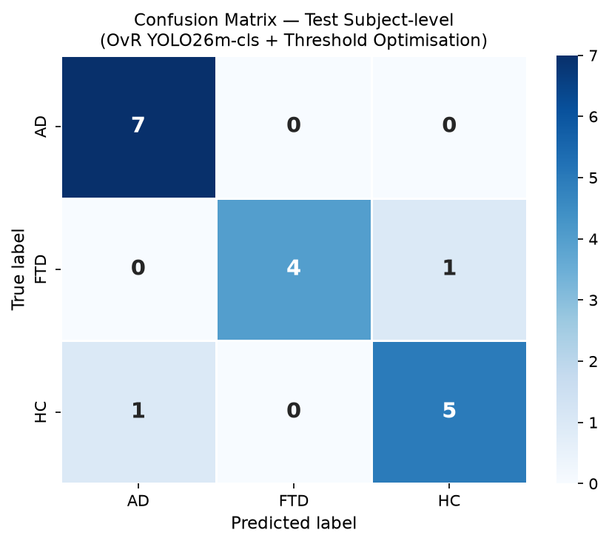
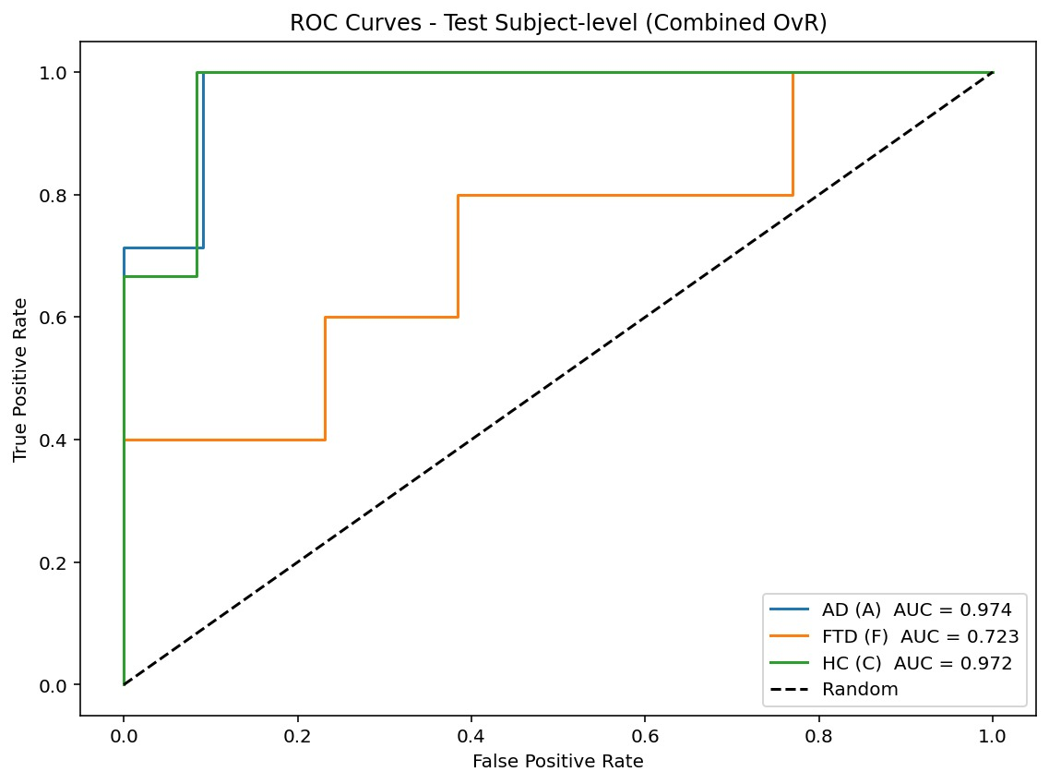
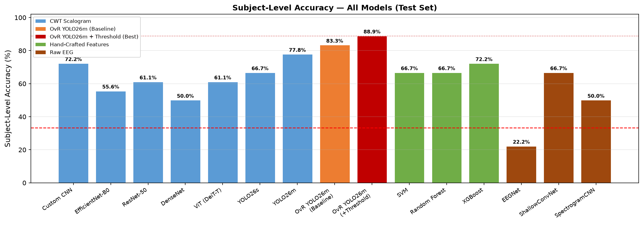
Best Model — OvR YOLO26m-cls + Threshold (88.89%)
AUC: AD=0.974 FTD=0.723 HC=0.972
AD: 7/7 ✓ | FTD: 4/5 | HC: 5/6

Slide 11
Conclusion & Future Work
Key Takeaways
• OvR YOLO26m-cls + Threshold → 88.89% subject accuracy, 88.77% F1 (best, 3-class held-out)
• OvR decomposition alone: +5.5% over single YOLO26m; threshold tuning adds further +5.6%
• XGBoost on 1,805 hand-crafted features: 72.2% — competitive & fully interpretable
• FTD is hardest class across all models (recall 34–40%) — consistent with all literature
• Strict 70/10/20 held-out split → clinically valid, leakage-free evaluation
Future Work
Limitations
• Scalogram mixup / time-warping augmentation
• Grad-CAM explainability maps
• Aperiodic EEG components (FOOOF)
• Recurrence complexity features
• Only 17 test subjects → limited statistical power
• EEGNet poorly suited to 20-s multi-class epochs
• LOSOCV papers not directly comparable

